Slide 1
SYNCHRONOUS FIFO DESIGN
USING VERILOG LANGUAGE

Slide 2
INTRODUCTION
WHAT IS FIFO(FIRST IN FIRST OUT)?
In computer programming fifo is an approach to handling program work request from queues and stacks so that oldest request can handled first.
In hardware it is either an array of flops or read/ write memory that store data given from one clock domain and on request supplies with the same data to other clock domain following the first in first out logic.
The clock domain that supplies data to fifo is often referred as WRITE OR INPUT LOGIC and the clock domain that reads data from the fifo is often referred as READ OR OUTPUT LOGIC.
FIFOs are used in designs to safely pass multibit data words from one clock domain to another or to control the flow of data between source and destination side sitting in the same clock domain.

Slide 3
If read and write clock domains are governed by same clock signals the FIFO is said to be SYNCHRONOUS and if read and write clock domains are governed by different (asynchronous ) clock signals FIFO is said to be ASYNCHRONOUS.
“FIFO full and FIFO empty” flags are of great concern as no data should be written in full condition and no data should read in empty condition, as it can lead to loss of data or generation of non relevant data.
The full and empty condition are controlled by using binary or grey pointers.

Slide 4
FIFO OPERATION

Slide 5
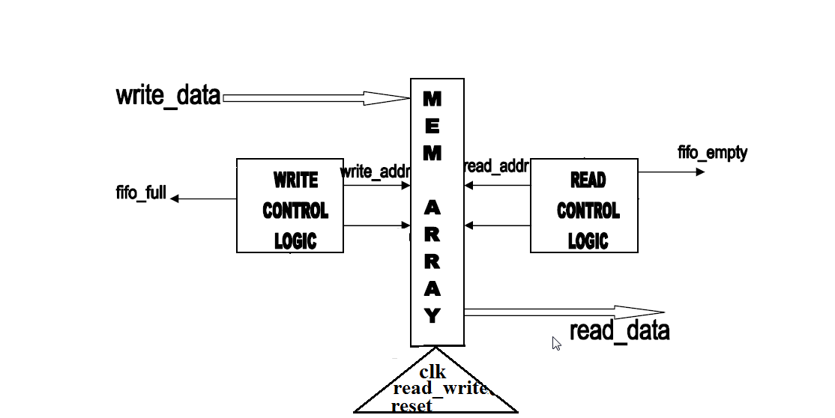
BASIC BLOCK DIAGRAM OF FIFO

Slide 6
SYNCHRONOUS FIFO
Synchronous FIFO refers to a FIFO design where data values are written sequentially into a memory array using a clock signal,and the values are sequentially read out into a memory array using the same clock signal.
In synchronous FIFO generation of empty and full flag straightforward as there is no clock domain crossing involved

Slide 7
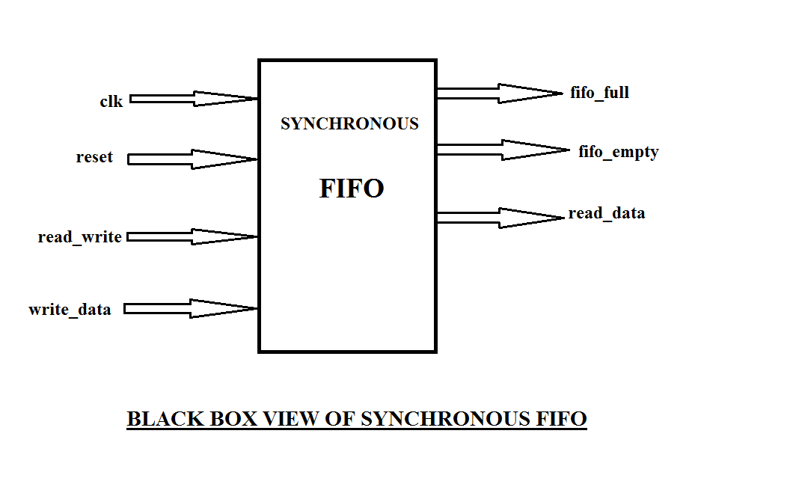
BLACK BOX VIEW OF SYNCHRONOUS FIFO

Slide 8
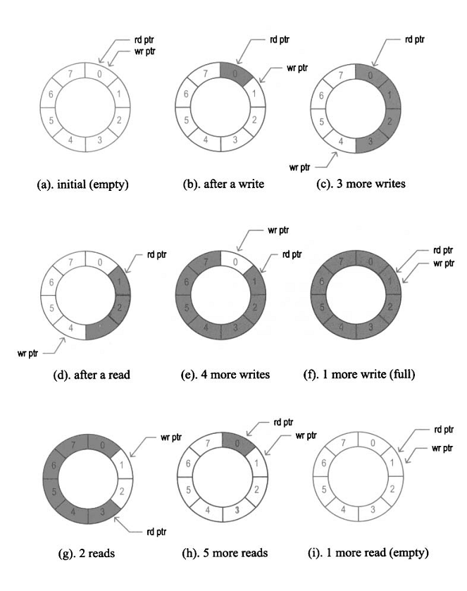
FIFO OPERATION(using ptr)

Slide 9
PORTS
CLK(input) : Clock input to the FIFO . This is a common input to both read and write sides of FIFO.
RESET(input) :Active low reset input.
FIFO_ FULL(output) :Indicates to the source that FIFOs internal memory has no space left to take in new data.
FIFO_ EMPTY(output) :Indicates to the source that FIFOs internal memory have no data to read.

Slide 10
WRITE_DATA(input) :Data input to the memory.
READ_DATA(output) :Data read out from the memory.
READ_WRITE(input) :When it is ‘0’ then write condition works,and when it become ‘1’ data read occurs.

Slide 11
MODELSIM SOFTWARE
About the Software: ModelSim is a multi-language HDL simulation environment by Mentor Graphics, for simulation of hardware description languages such as VHDL, Verilog and SystemC, and includes a built-in C debugger. ModelSim can be used independently, or in conjunction with Altera Quartus or Xilinx ISE.. Simulation is performed using the graphical user interface (GUI), or automatically using scripts.

Slide 12
CODE:
module project (read_data,fifo_full,fifo_empty,write_data,clk,reset,read_write); output regfifo_full,fifo_empty; output reg [7:0]read_data; input read_write,clk,reset; input [7:0]write_data; reg [3:0]write_addr,read_addr; reg[7:0]mem[7:0]; initial begin write_addr=8'd0; read_addr=8'd0; fifo_full=0; fifo_empty=1; end

Slide 13
always @(posedgeclk , posedge reset) begin if(reset) begin write_addr<=8'd0; read_addr<=8'd0; fifo_empty=1; fifo_full=0; end else begin if(read_write==0) begin mem[write_addr]<=write_data; write_addr<=write_addr+1; read_data=0; if(write_addr==7) fifo_full=1; end else if(read_write==1) begin read_data<=mem[read_addr]; read_addr<=read_addr+1; end end end

Slide 14
always@(posedgeclk , posedge reset) begin if(write_addr==read_addr&&read_write) begin fifo_empty=1; end else fifo_empty=0; end endmodule

Slide 15
TESTBENCH:
module tb_project; regread_write,clk,reset; reg [7:0]write_data; wire fifo_full,fifo_empty; wire [7:0]read_data; project q1(read_data,fifo_full,fifo_empty,write_data,clk,reset,read_write); initial begin clk=1; end always begin #5 clk=~clk; end

Slide 16
initial begin reset=1; read_write=0; write_data=8'd12; #15 write_data=8'd13; reset=0; #10 write_data=8'd14; #10 write_data=8'd15; #10 write_data=8'd2; #10 write_data=8'd3; #10 write_data=8'd4; #10 write_data=8'd11; #10 write_data=8'd14; #35 read_write=1; end endmodule

Slide 17
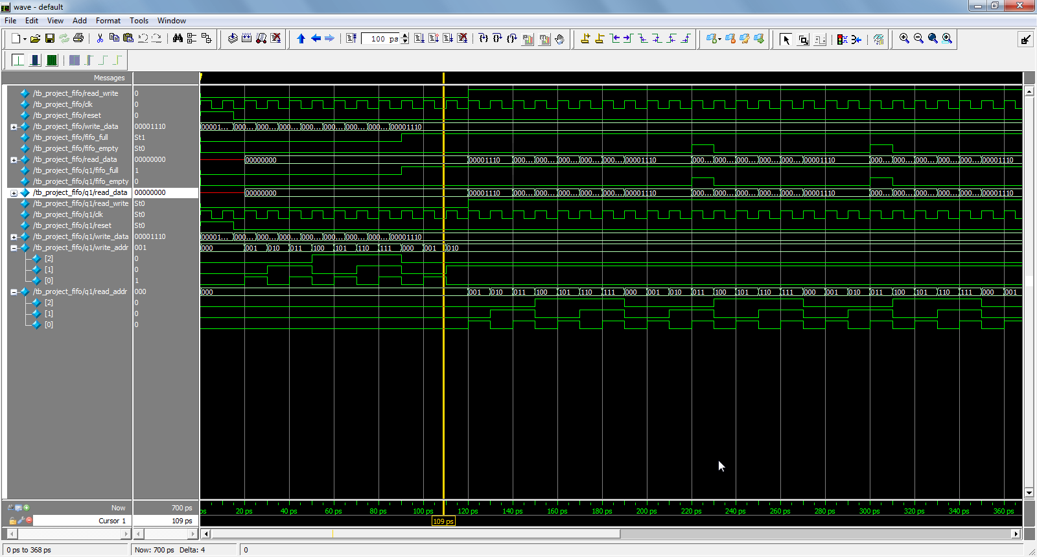
WAVEFORM:

Slide 18
THANK YOU

